Slide 1
Discussion 04:
Data Abstraction and Sequences
Jennifer Tsui (jtsui@berkeley.edu)
Website: jentsui.github.io
Slides for each week will be posted on my website!

Slide 2
Announcements
HW 3 due tonight
Maps project due Thursday 2/28
Submit Hog Composition by Tuesday 2/26
Sign up for a CSM Section
Sign up for 1-on-1 Tutoring

Slide 3
Data Abstraction

Slide 4



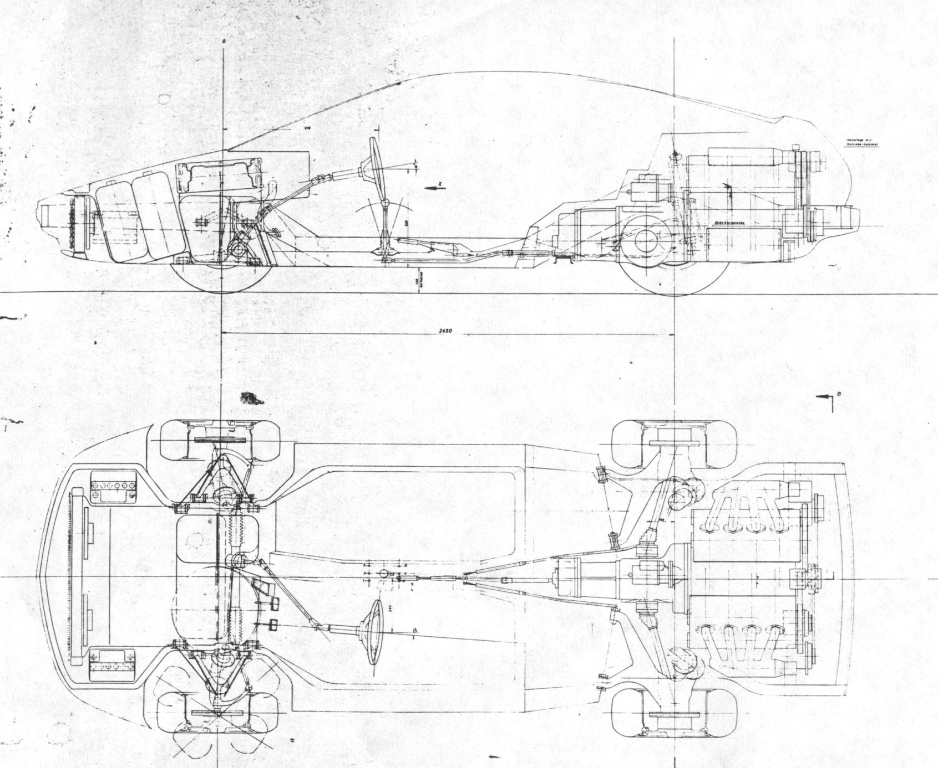


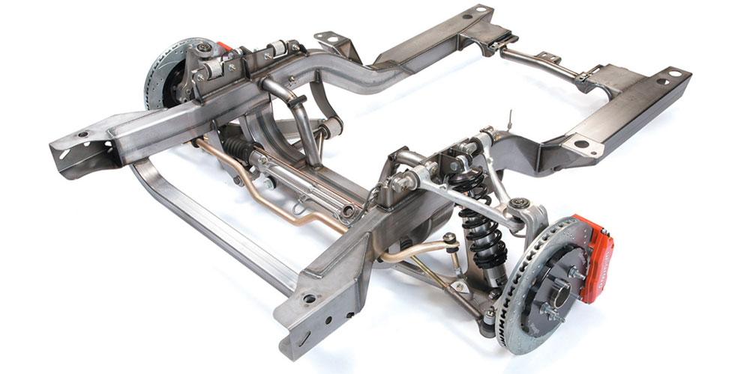
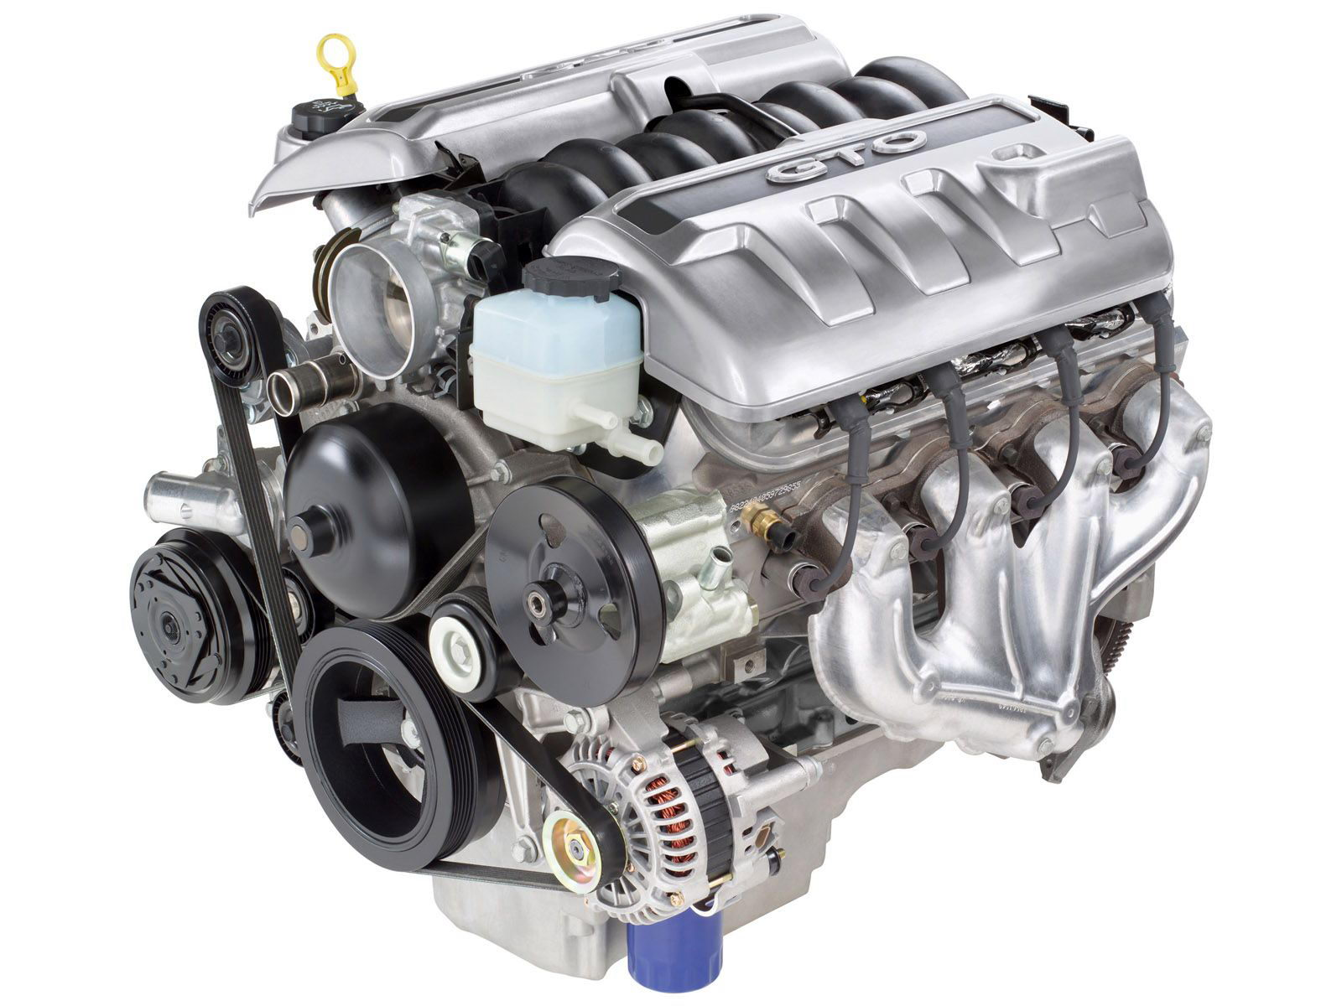
Car abstraction
abstraction barrier
What the car manufacturer sees:
What the end-user sees/uses:

Slide 5
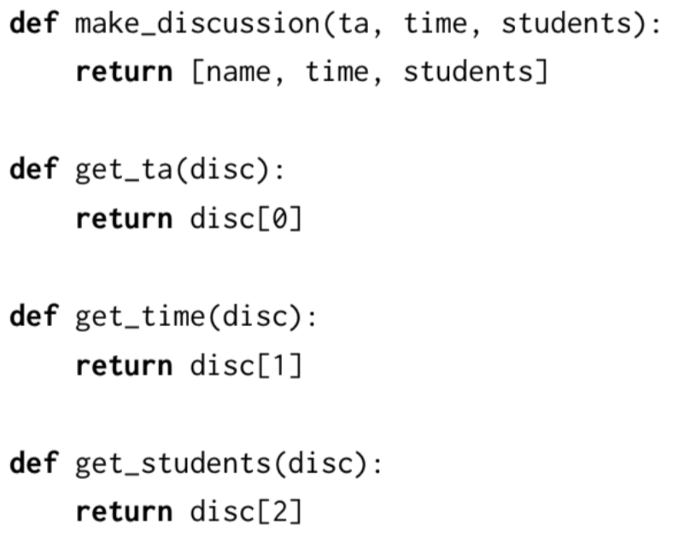
Discussion Section ADT
abstraction barrier
The implementation:
What the end-user sees/uses:
Constructor: make_discussion
Selectors:
get_ta
get_time
get_students
Note: the body (implementation of these functions) is hidden!

Slide 6
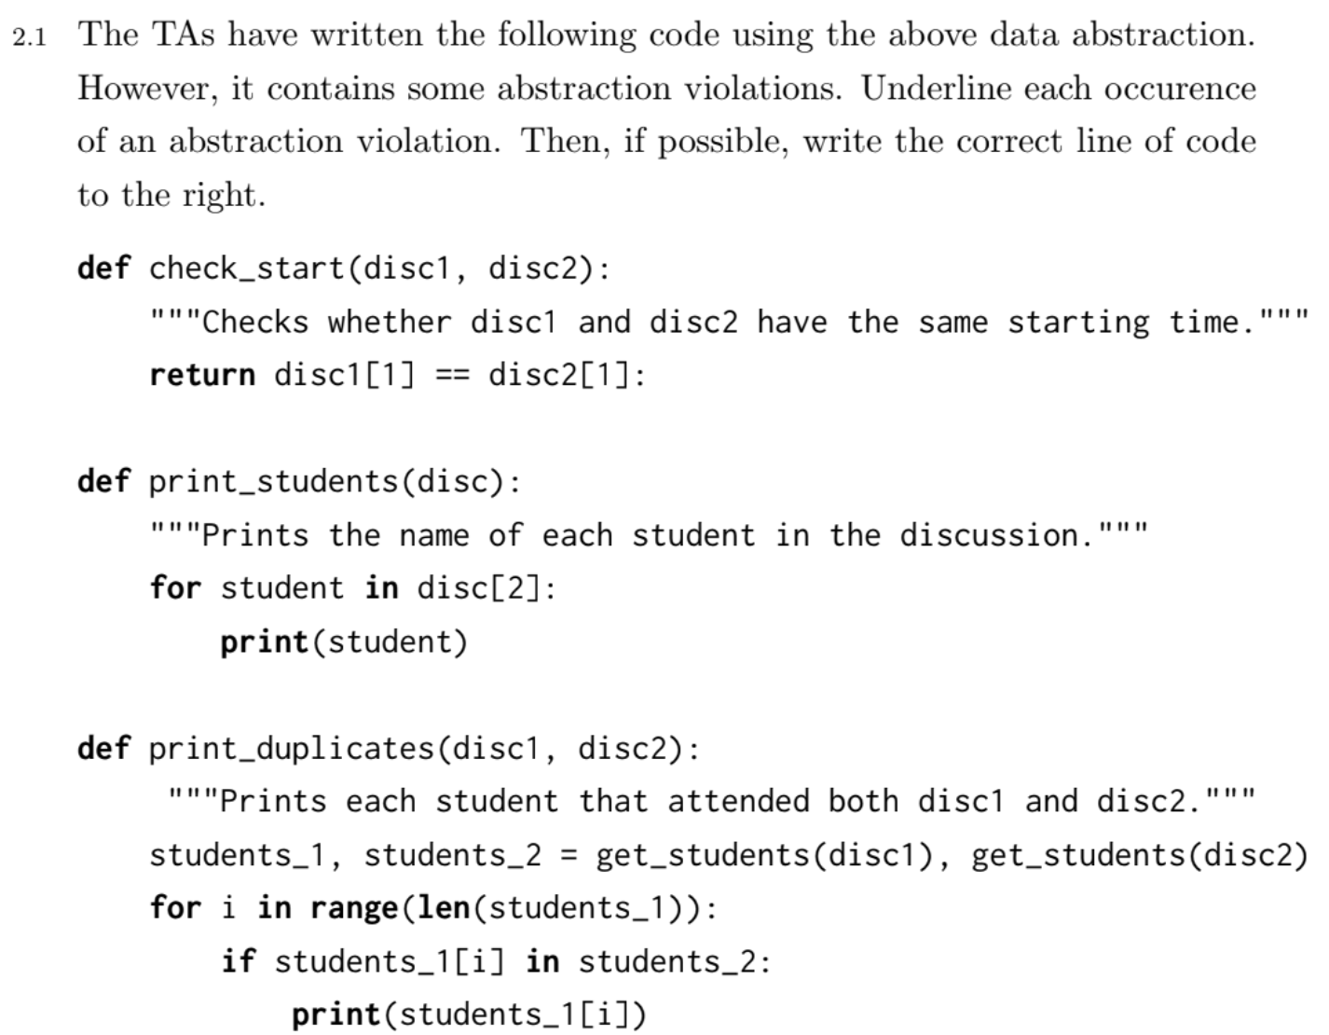
Is there an abstraction barrier violation?
If so, fix it!
Discussion ADT:

Slide 7
Is there an abstraction barrier violation?
If so, fix it!
Discussion ADT:
We violated the abstraction barrier!
Need to use selector functions to get the time
Fix:
return get_time(disc1) == get_time(disc2)

Slide 8
Is there an abstraction barrier violation?
If so, fix it!
Discussion ADT:

Slide 9
Is there an abstraction barrier violation?
If so, fix it!
Discussion ADT:
We violated the abstraction barrier!
Need to use selector functions to get the student
Fix:
for student in get_students(disc)

Slide 10
Is there an abstraction barrier violation?
If so, fix it!
Discussion ADT:

Slide 11
Is there an abstraction barrier violation?
If so, fix it!
Discussion ADT:
No abstraction barrier violation :)
We used get_students selector to find students_1 and students_2, which are lists.
We can index into those lists safely.

Slide 12
Q2.2: Changing the Implementation
Now, we implement a discussion as a dictionary. get_time is now implemented as disc[“time”] rather than disc[0]
The original code would’ve errored.
After removing abstraction barrier violations, the code will still work with this new implementation!

Slide 13
Attendance:
links.cs61a.org/jen
Password:

Slide 14
List Comprehensions

Slide 15
[map-expr for name in iter-expr if filter-expr]
(Optional) Filter: get rid of elements that don’t fulfill condition
Map: Applies map expression to each element
Input: an existing list
Output: a new list
[x*x for x in [1, 2, 3, 4, 5] if x % 2 == 1]
Keeps elements where x % 2 == 1
[1, 3, 5]
Squares each element
[1, 2, 3, 4, 5]
[1, 9, 25]

Slide 16
Code Writing with Lists

Slide 17
Recursion
Base Case
2) Recursive Call(s)
Assume your function works on each subproblem
Think about what calling our function on each subproblem should evaluate to
3) Using recursive calls to reach final solution
Combine results of subproblems to get our final answer

Slide 18
Recursion on lists
Typical Base Case: an empty list
In code: if not lst:
Typical smaller subproblem: the list excluding its first element
We can make some choices on the first element
In code: the rest of the list is lst[1:]
If lst = [1, 2, 3], then lst[1:] will give us [2, 3]

Slide 19
Recursion on lists
Sum elements of a list:
sum([]) => 0
sum([5, 10, 1]) => 16
sum([10, 1]) => 11
def sum(lst):
if not lst:
return 0
return lst[0] + sum(lst[1:])

